Slide 1
CORONARY HEART DISEASE
Here is where your presentation begins

Slide 2
CONTENTS OF THIS TEMPLATE
Here’s what you’ll find in this Slidesgo template:
A slide structure based on a disease presentation structure, which you can easily adapt to your needs. For more info on how to edit the template, please visit Slidesgo School or read our FAQs.
An assortment of graphic resources that are suitable for use in the presentation can be found in the alternative resources slide.
A thanks slide, which you must keep so that proper credits for our design are given.
A resources slide, where you’ll find links to all the elements used in the template.
Instructions for use.
Final slides with:
The fonts and colors used in the template.
A selection of illustrations. You can also customize and animate them as you wish with the online editor. Visit Storyset to find more.
More infographic resources, whose size and color can be edited.
Sets of customizable icons of the following themes: general, business, avatar, creative process, education, help & support, medical, nature, performing arts, SEO & marketing, and teamwork.
You can delete this slide when you’re done editing the presentation.

Slide 3
TABLE OF CONTENTS
01
04
02
05
03
06
THE DISEASE
PATHOLOGY
You can describe the topic of the section here
You can describe the topic of the section here
DIAGNOSIS
TREATMENT
You can describe the topic of the section here
You can describe the topic of the section here
MEDICAL ADVICES
CONCLUSIONS
You can describe the topic of the section here
You can describe the topic of the section here

Slide 4
INTRODUCTION
You can give a brief description of the topic you want to talk about here. For example, if you want to talk about Mercury, you can say that it’s the smallest planet in the entire Solar System

Slide 5
01
ABOUT THE DISEASE
You can enter a subtitle here if you need it

Slide 6
CORONARY ARTERY DISEASE
01
02
ANGINA
HEART ATTACK
Mercury is the closest planet to the Sun and the smallest one in the Solar System
Despite being red, Mars is a very cold place. It’s full of iron oxide dust

Slide 7
CAUSES OF HEART DISEASE
1,200
3,600
SMOKING
OBESITY
Mercury is the smallest planet
Jupiter is a gas giant planet
2,400
4,800
GENETICS
DIABETES
Mars is actually a cold place
Neptune is very far from the Sun

Slide 8
CARDIOVASCULAR PATHOLOGY
MERCURY
JUPITER
NEPTUNE
It’s the closest planet to the Sun
Jupiter is the biggest planet of them all
It’s the farthest planet from the Sun
SATURN
MARS
Saturn is composed mostly of hydrogen
Despite being red, Mars is a cold place

Slide 9
DISEASE STAGES
STAGE 1
STAGE 2
STAGE 3
Despite being red, Mars is a cold place. The planet is full of iron oxide
Jupiter is a gas giant and the biggest planet in the Solar System
Saturn is a gas giant and the only planet with rings. It’s a beautiful one!

Slide 10
SYMPTOMS IN THE BODY
01
03
02
04
MERCURY
VENUS
Mercury is the closest planet to the Sun
Venus is the second planet from the Sun
MARS
JUPITER
Despite being red, Mars is a cold place
It’s the biggest planet in the Solar System

Slide 11
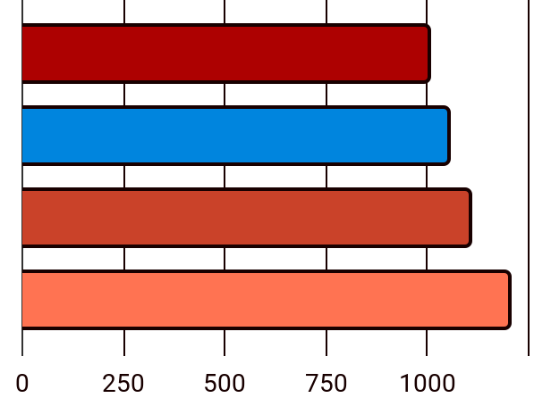
RISK FACTORS
1,000
PRESSURE
Mercury is small
1,050
CHOLESTEROL
Venus is very hot
1,100
GENDER
Mars is actually cold
1,200
GENETICS
Follow the link in the graph to modify its data and then paste the new one here. For more info, click here
Earth is where we live

Slide 12
24,000
33,300
38,600
Jupiter is a gas giant and the biggest planet
Saturn is a gas giant planet and has several rings
Neptune is the farthest planet from the Sun

Slide 13
AWESOME WORDS

Slide 14
—SOMEONE FAMOUS
“This is a quote. Words full of wisdom that someone important said and can make the reader get inspired.”

Slide 15
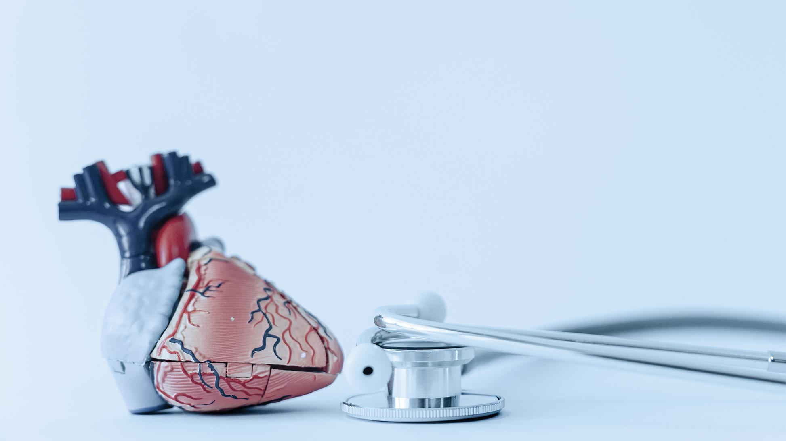
A PICTURE IS WORTH A THOUSANDS WORDS

Slide 16
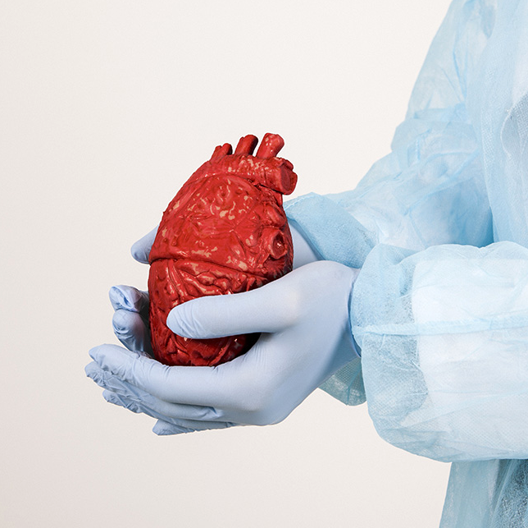
A PICTURE REINFORCES THE CONCEPT
Images reveal large amounts of data, so remember: use an image instead of a long text. Your audience will appreciate it

Slide 17
HEART DISEASE DIAGNOSIS
MERCURY
VENUS
NEPTUNE
It’s the closest planet to the Sun
Venus is the second planet from the Sun
It’s the farthest planet from the Sun
SATURN
JUPITER
MARS
Saturn is composed mostly of hydrogen
Jupiter is the biggest planet of them all
Despite being red, Mars is a cold place

Slide 18
HEART ATTACK PREVENTION
01
02
03
04
JAN
MAR
APR
MAY
VENUS
MARS
MERCURY
NEPTUNE
Venus has high temperatures
Mars is actually a very cold place
It’s the closest planet to the Sun
Neptune is very far from the Sun

Slide 19
DISEASE TREATMENT
01 | INITIAL STAGE
 | MEDICINE | Mercury is the smallest planet
02 | INTERMEDIATE STAGE
 | MEDICINE | Venus has very high temperatures
03 | ADVANCED STAGE
 | MEDICINE | Earth is the planet where we all live

Slide 20
RECOMMENDATIONS
25%
75%
65%
35%
MERCURY
SATURN
MARS
VENUS
It’s the closest planet to the Sun
Saturn is the only planet with rings
Despite being red, Mars is cold
Venus has very high temperatures

Slide 21
PREVALENCE
2,300
JUPITER
Jupiter is a gas giant planet
1,500
NEPTUNE
Neptune is very far from the Sun

Slide 22
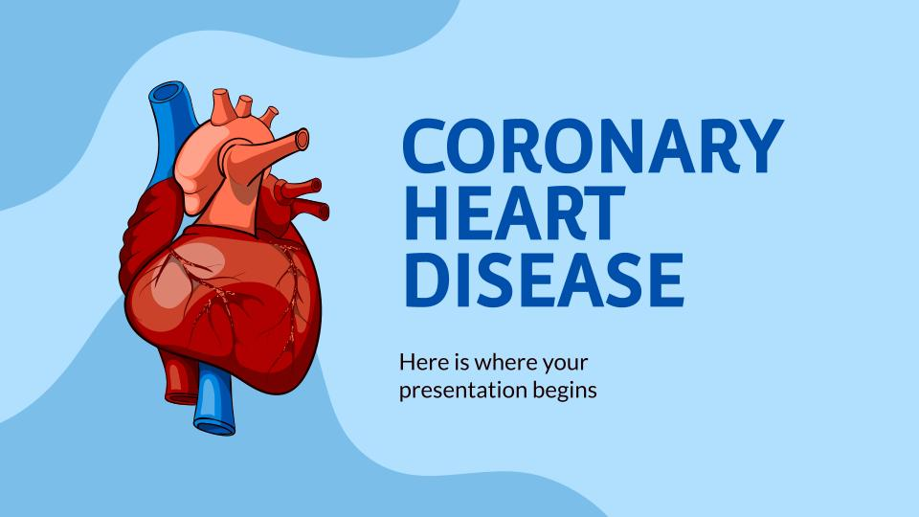
WATCH OUR CONCLUSIONS
You can replace the image on the screen with your own work. Just right-click on it and select “Replace image”

Slide 23
OUR TEAM
DOCTORS
NURSES
Liam Smith
Olivia Johnson
Noah Miller
Emma Brown
John Freeman
Simone Doe
Oliver Jones
Ava Williams
Elijah Sofer
Charlotte Garcia
Gregory Smith
Samantha Davis

Slide 24
REFERENCES
AUTHOR (YEAR). Title of the publication. Publisher
AUTHOR (YEAR). Title of the publication. Publisher
AUTHOR (YEAR). Title of the publication. Publisher
AUTHOR (YEAR). Title of the publication. Publisher
AUTHOR (YEAR). Title of the publication. Publisher
AUTHOR (YEAR). Title of the publication. Publisher
AUTHOR (YEAR). Title of the publication. Publisher
AUTHOR (YEAR). Title of the publication. Publisher

Slide 25
THANKS!
Do you have any questions?
youremail@freepik.com
+91 620 421 838
yourcompany.com
Please keep this slide for attribution

